Slide 1

CAPSTONE PROJECT ON SOCIAL ENGINEERING ATTACKS: PHISHING

Slide 2
Submitted to: TedPrimeHUB In Partial Fulfillment of the Requirements of the Cybersecurity July 15- September 14 Class of 2024. Presented By Omokhepen O. Gbolade 08/2024

Slide 3
INTRODUCTION
Social engineering refers to the various ways cybercriminals manipulate people into divulging confidential information or granting unauthorized access to their personal space or devices. However, I will focus on PHISHING, one of the most prevalent forms of online scams in our daily activities. According to Cisco.com, “phishing is the practice of sending fraudulent communications that appears to come from legitimate and reputable source, usually through email and text messaging. The attacker’s goal is to steal money, gain access to sensitive data and login information, or to install malware on the victim’s device”.
This project research aims to present the best awareness strategy for social engineering, on how to identify and avoid cyber-attacks such as phishing. To achieve this, a malicious link was first created using a free website platform, followed by a focus group with colleagues from a church's WhatsApp platform. In this group, awareness training was conducted on social engineering attacks focusing on phishing, and how to identify and avoid it. Afterwards, the malicious link was posted to the group and findings were made on their responses to the link and evaluation on how effective the awareness training was.
Below is a step-by-step process on how the research was conducted.

Slide 4
CREATING THE MALICIOUS LINKS
For this project, a malicious link was created using the bitly.com website platform. First, an account was created leading to the landing page. The page menu was clicked on to build and design the malicious link, followed by the link being published for easy tracking.
The first link was created with information to lure the participants into clicking the link to send birthday greetings to the founder of the church and whoever clicks, will land on a page informing them that they have been “busted”. The same process was used for the second link and the link generated was for them to send their information for a children’s Teacher Training. See the links below.
https://bit.ly/m/winnerschapelpapa70thbirthdaycelebrate- The first link
https://bit.ly/m/Winnerschapelchildrensteachertraining- The second link

Slide 5
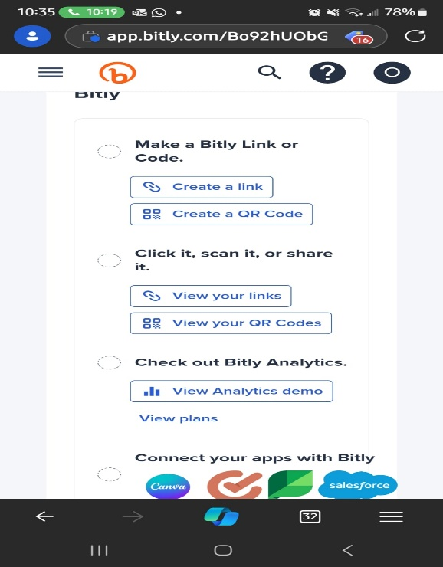
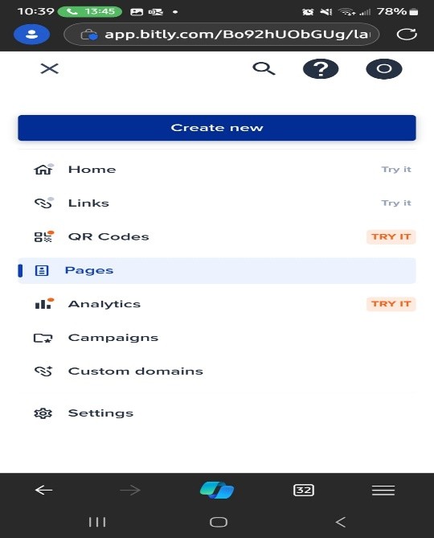

Slide 6
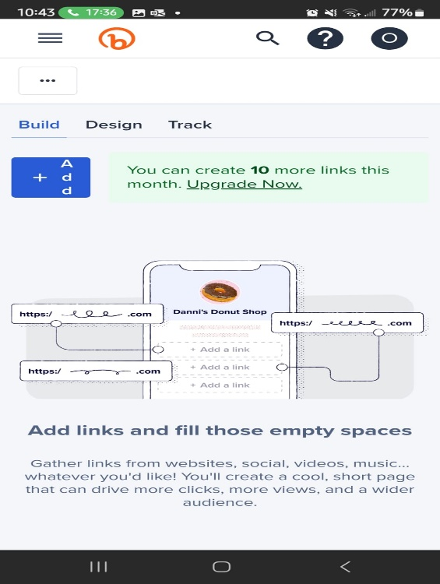
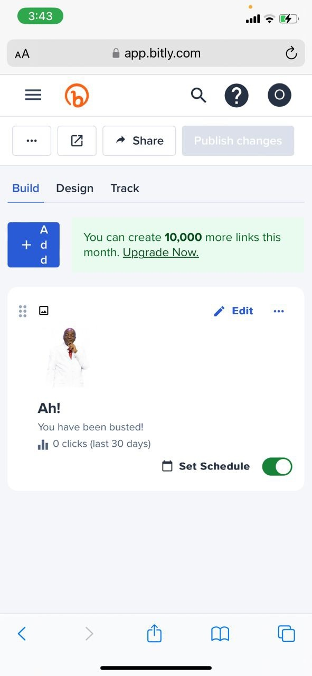
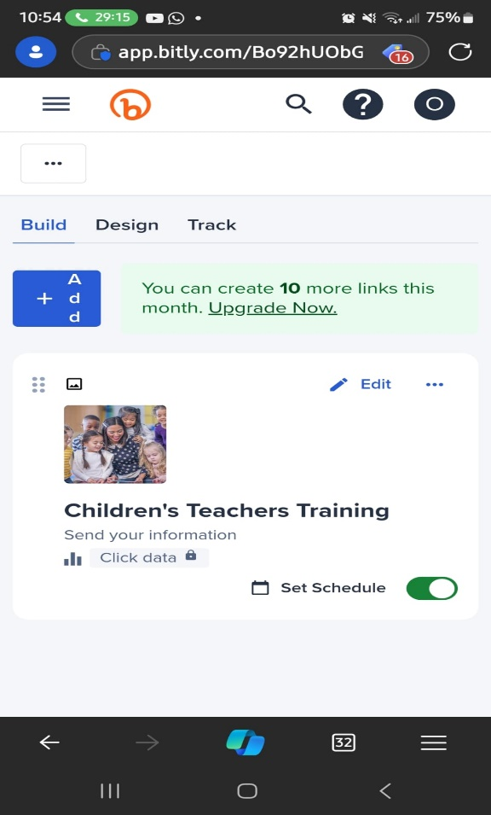


The first link
Second link

Slide 7
AWARENESS TRAINING ON PHISHING
An awareness training was conducted using the focus group created on a WhatsApp platform and most of the things below were shared to inform the participants on how to identify and avoid phishing scams. At one point or another, we have received emails, text messages, and even calls requesting that we click a link, send a code, or enter our confidential information. This type of cyberattack is called PHISHING. Unfortunately, many people still fall victim to these scams because they are not patient enough to verify the information before acting or not aware of ways to avoid it when received.
However, there are tips to identify and avoid phishing scams. These include, but are not limited to:
What we call the zero-trust principle. This simply means you don’t trust any messages, emails, or calls until they are verified.
Verify the sender’s email address—most businesses will use their domain names (e.g., Faithtabernacle.org).

Slide 8
Continuation points
• Be careful with your personal or confidential information. That’s why your banks will tell you, “We won’t ask for your PIN or password.”
• If you feel your information is compromised, quickly reset your password and alert your bank and other institutions.
• Update your devices’ software regularly. You can put it on auto-update.
• Use strong passwords and do not save your information on your phones. A password manager can help with storing your passwords.
▪︎ Use two-factor authentication on your devices.
Following these tips can help avoid having leaked information.
Don’t be in a hurry to click any link, no matter how real it looks

Slide 9
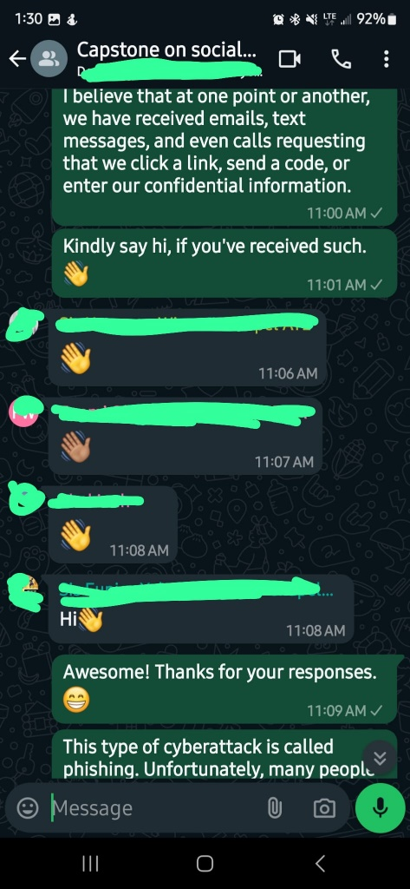
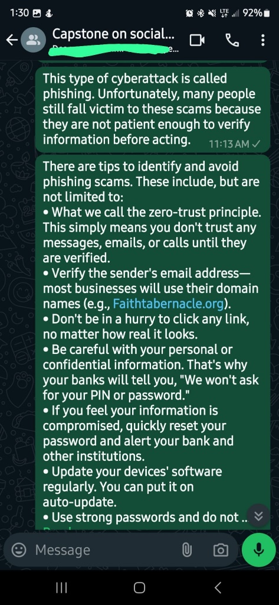
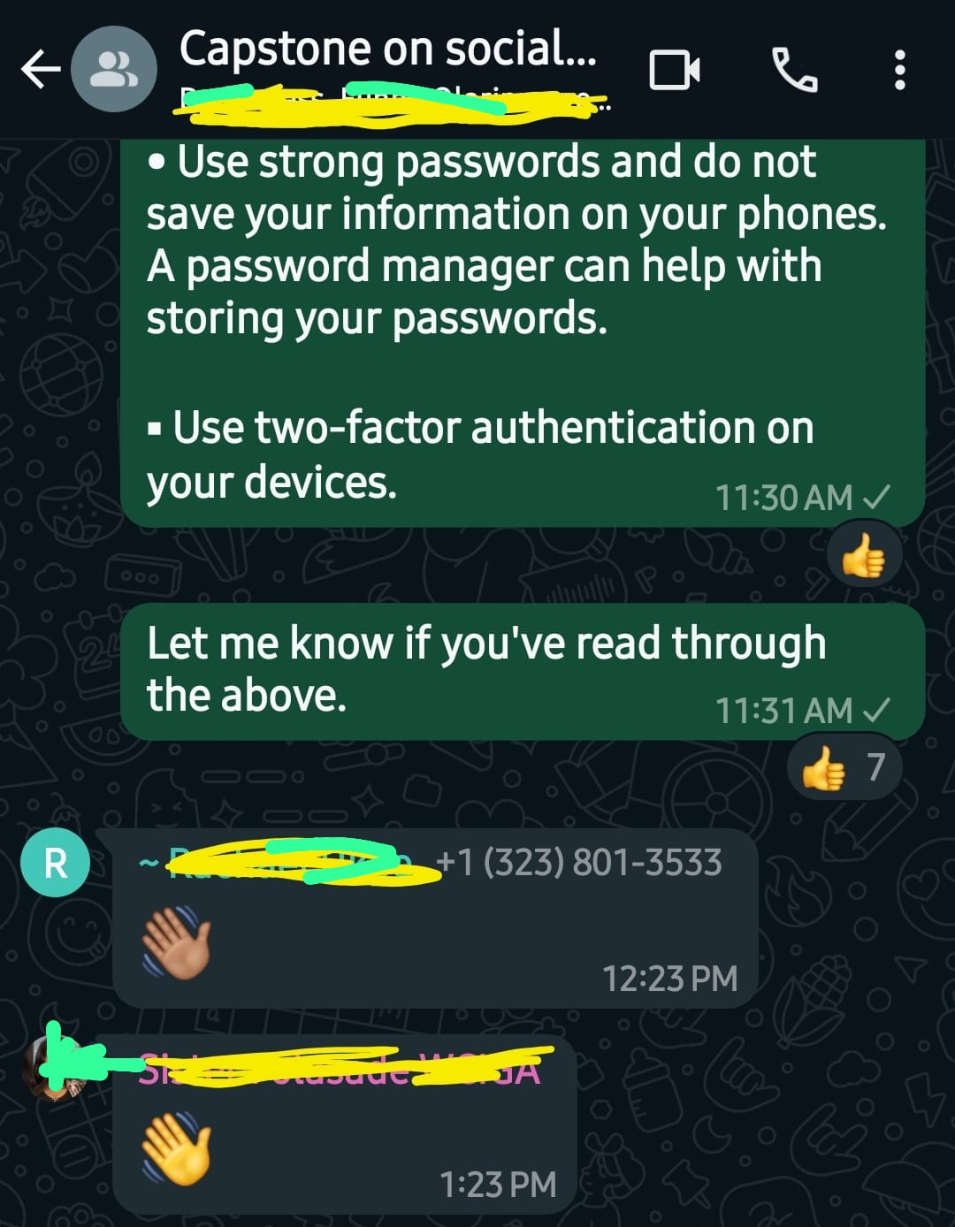
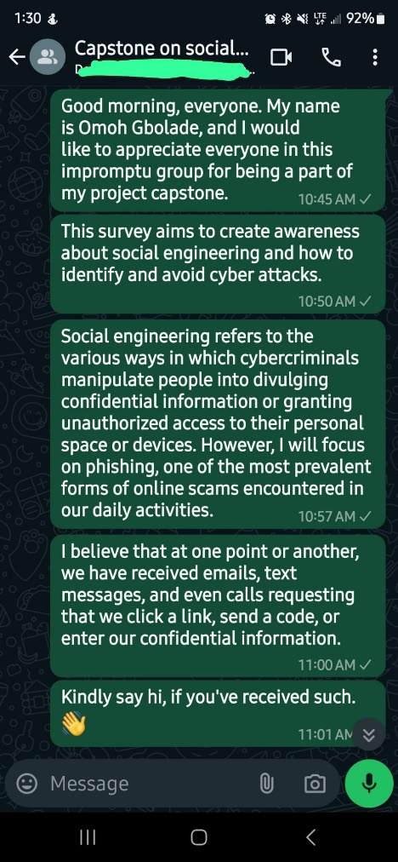

Slide 10
AWARENESS TRAINING EVALUATION
The first malicious link created was posted on the group a few hours after the training to evaluate the effectiveness of the training and the findings below were the outcome. Out of a total of 19 active participants, seven members from the group still fell victim by clicking on the assumed malicious link. Moreso, we had three people outside the group because the tracking showed another location which might mean, the message was forwarded from the group.

Slide 11
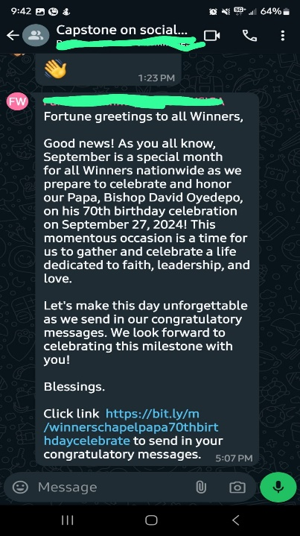
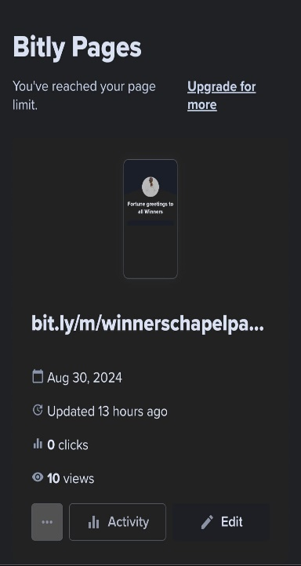
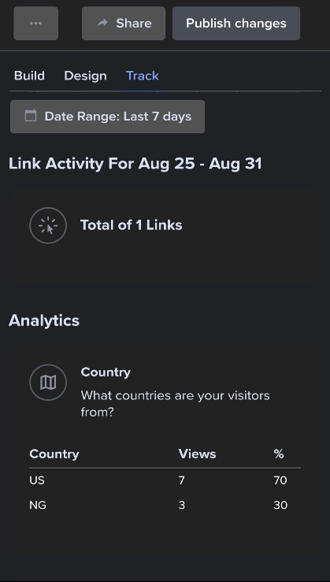
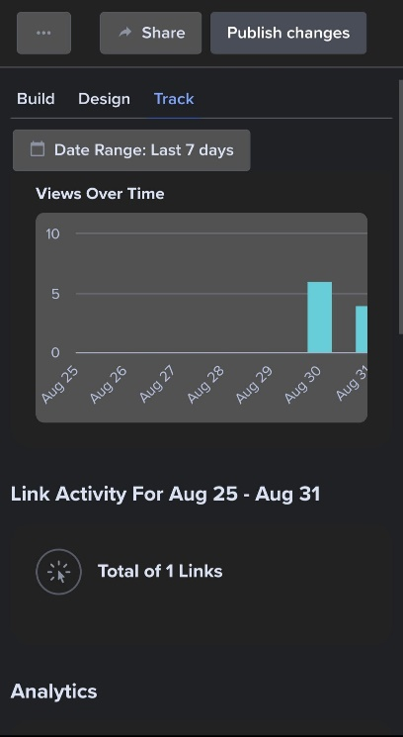
FINDINGS

Slide 12
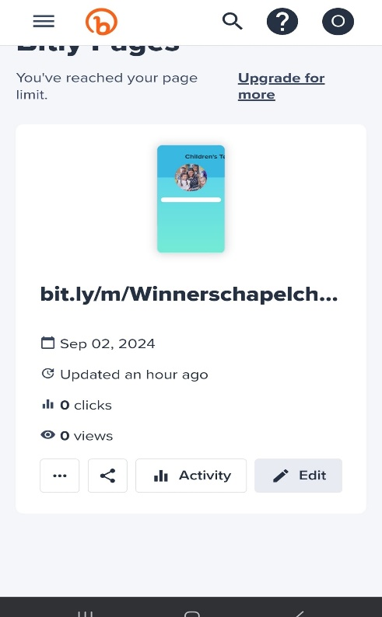
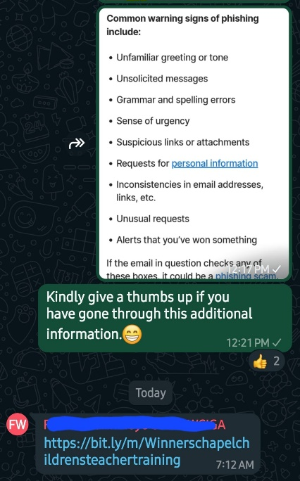
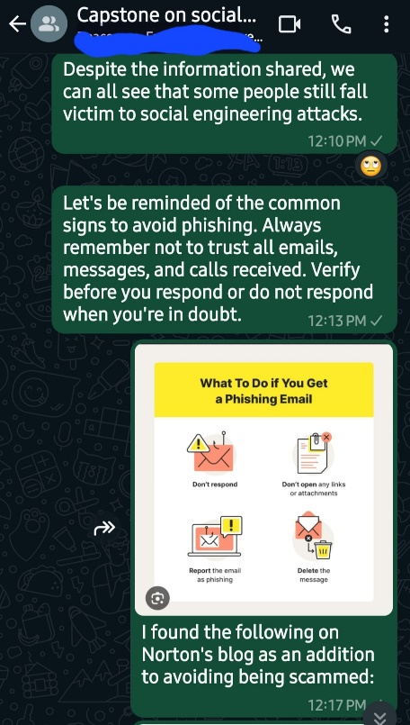
FINDING

Slide 13
CONCLUSION
Knowing fully well that these attackers always devise new ways to scam people, the best strategy to avoid or minimize social engineering attacks is for organizations to conduct regular awareness training and testing for their employees.

Slide 14
REFERENCE
Us.norton.com https://www.cisco.com/c/en/us/products/security/email-security/what-is-phishing.html
Cisco.com https://us.norton.com/blog/online-scams/what-is-phishing#:~:text=Ending%20the%20interaction%20after%20clicking,you%20clicked%20a%20phishing%20link

